Slide 1
Connect to HANA DB
Milind Parab

Slide 2
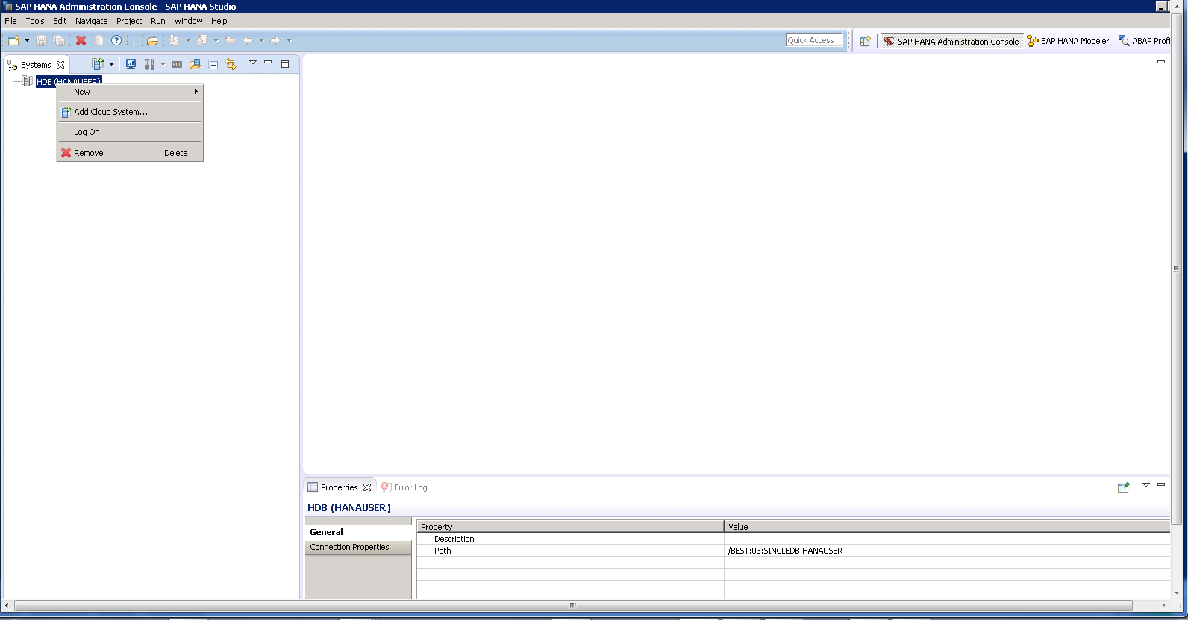
Remove old connection.

Slide 3
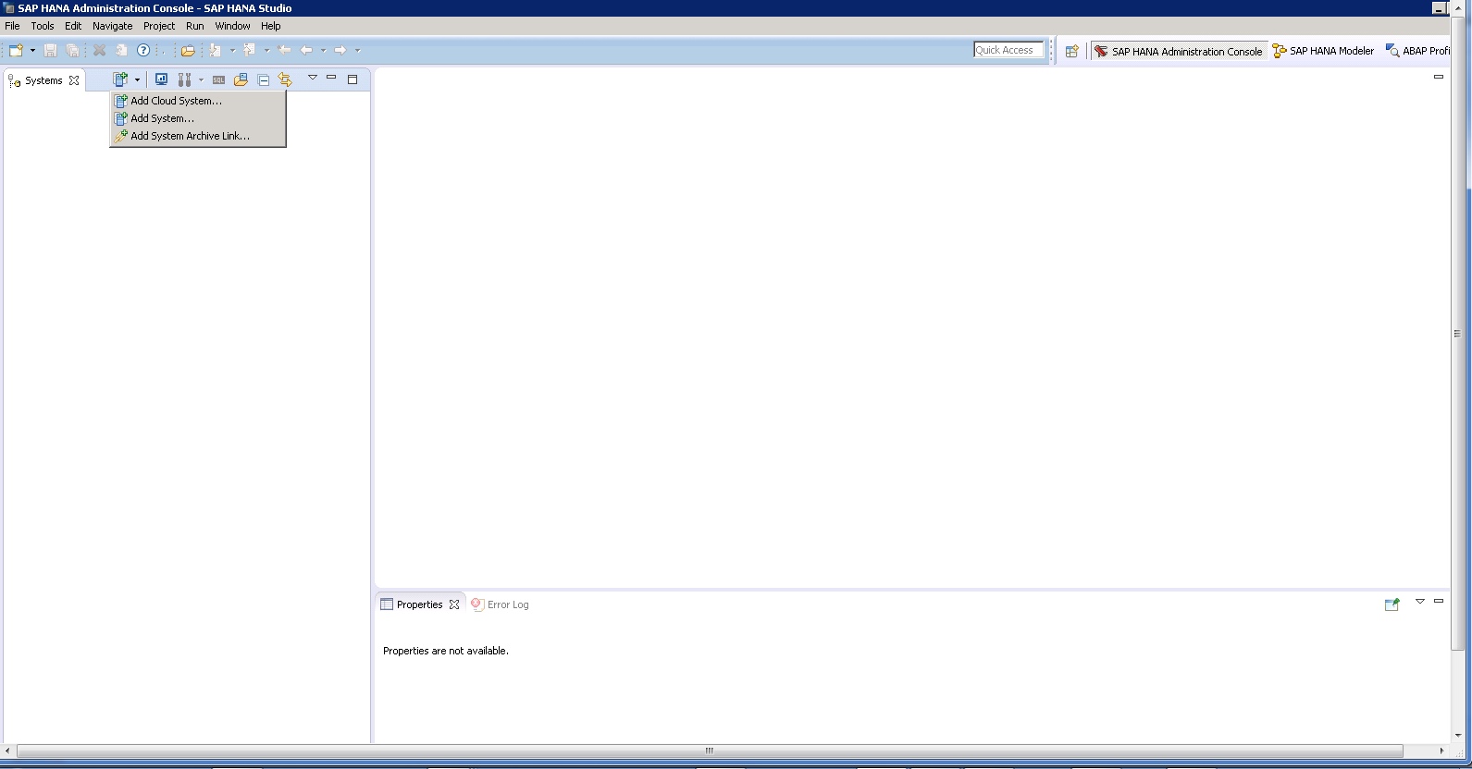
Add a new system.

Slide 4
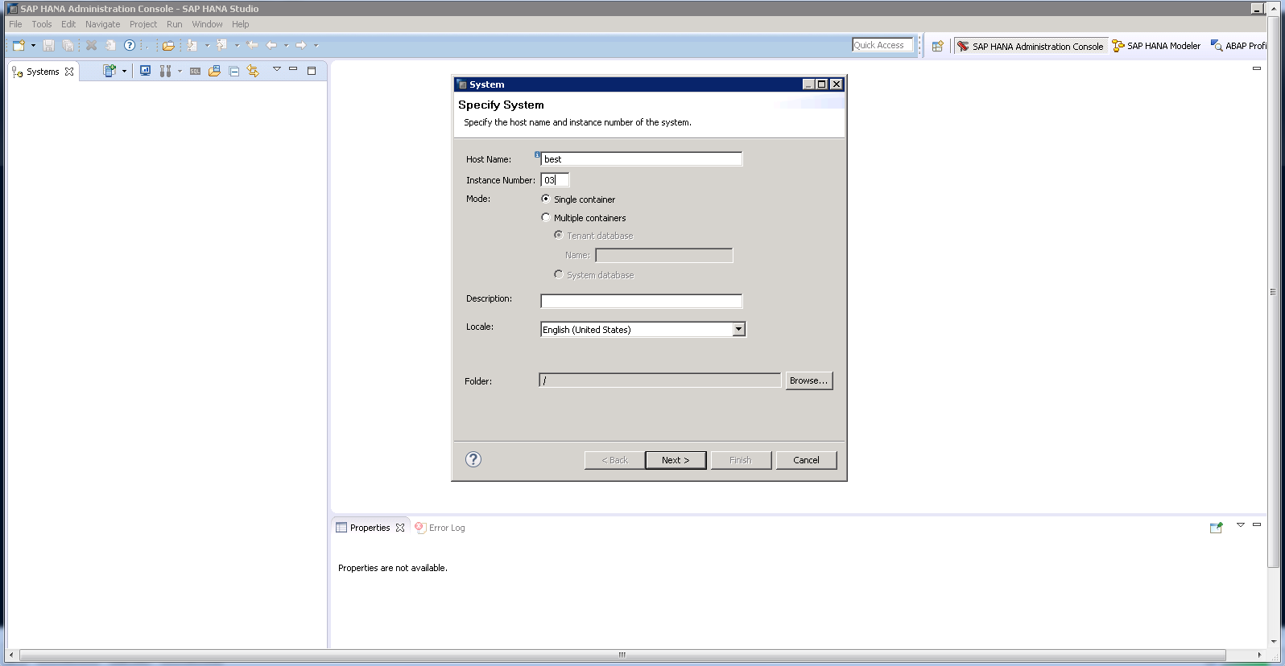
Update host name and click on next.

Slide 5
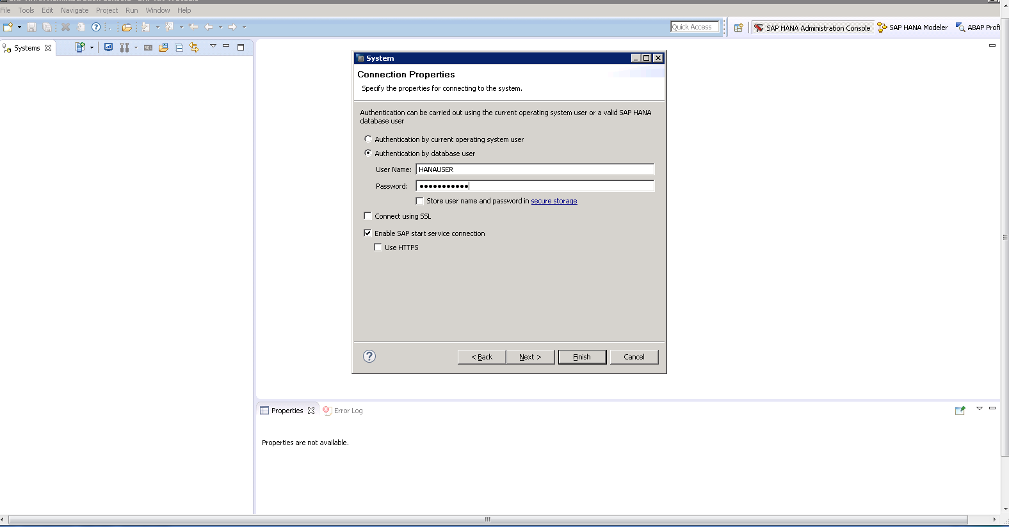
Use user name and password from hana administrator.

Slide 6
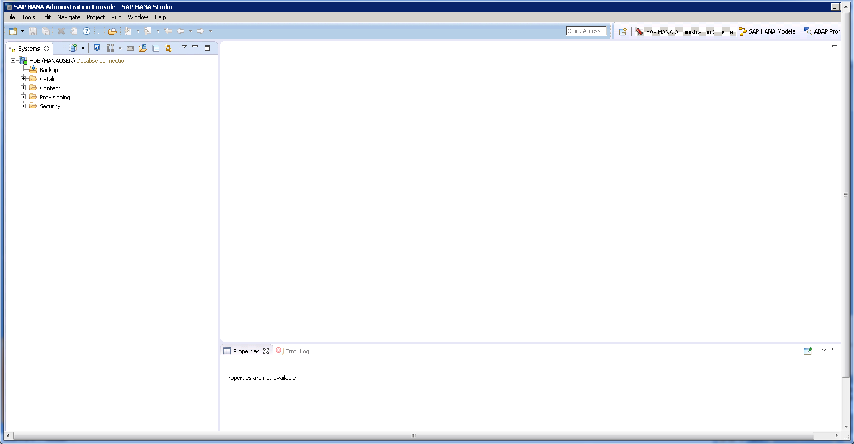
Connected Successfully.

